Slide 1
R Markdown
Olina Ngwenya, MSc
R Intermediate Course at UCT
Introduction to R Markdown
Nov 11-13, 2019

Slide 2
R Markdown
It is a unified authoring framework for data science
It combines your code, its results and your prose commentary
You can use a single file R Markdown file to both
  Save and execute code
  Generate high quality reports that can be shared with an audience
R Markdown file- a text file that has the extension
.Rmd:

Slide 3
R Markdown files are designed to be used in three ways:
• For communicating to decision makers, who want to focus on
the conclusions, not the code behind the analysis.
• For collaborating with other data scientists (including future
you!), who are interested in both your conclusions, and how
you reached them (i.e., the code).
• As an environment in which to do data science, as a modern day
lab notebook where you can capture not only what you did, but
also what you were thinking.

Slide 4
Continued
R Markdown documents are fully reproducible and support dozens of static and dynamic output formats.
. You can choose to export the finished report html file, word document, pdf document, RTF,ODT etc.
You can make data analysis reports using R Mark down.

Slide 5
Getting Started in R Markdown
Open a new .Rmd file
-File--New file--R Markdown
-New R Mark down wizard will pop up and add title and author.
Write document by editing the template.
- Already there is some information for you to use
Knit document: to create a report

Slide 6
R Markdown(Rmd) structure
YAML Header- An (optional) YAML header surrounded by ---s.
-at the start of the file
Text- Narration formatted with markdown (Writing anything)
-Text mixed with simple text formatting like # heading and _italics_.
Code Chunks- Chunks of R code surrounded by ```. Each chunk
  Begins with ```{r}
  Ends with ```

Slide 7
Continued…
Initial code chunk-that is where you load your necessary packages.
If you don’t want to see your codes on your report write echo=FALSE on your code chunk.
Sections- put a #-for a section, ##-for subsection etc

Slide 8
Continued…
When you knit the document R Markdown sends the .Rmd file to
knitr, which executes all of the code chunks and creates a new
Markdown (.md) document that includes the code and its output.
The Markdown file generated by knitr is then processed by pandoc,
which is responsible for creating the finished file.
The advantage of this two-step workflow is that you can create a very wide range of output formats,

Slide 9
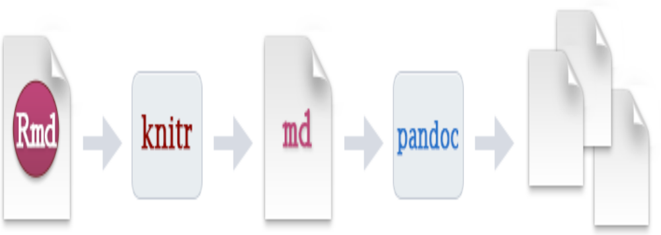
Continued…

